Slide 1
WHERE AND HOW DO I START MY JOB HUNT?

Slide 2

TEAM - 3
FORECASTING AND ANALYZING THE JOB MARKET IN USA
BAN-612
Professor: Lan Wang

Slide 3
CONTENTS
Introduction
Objective
Setup and Tools
Data Attributes
Research Questions
Data Analysis
Conclusion
Q & A

Slide 4

INTRODUCTION
Our project analyzes job postings from major U.S. locations. We'll use web scraping to identify top trending job titles, categorize roles (full-time, part-time, Contract based roles), and assess work job posting in last few months, Skill sets required for these job postings. We'll also examine top 3 companies hiring, posting volumes of all the job counts within a 25-mile radius, providing insights for job seekers and recruiters.

Slide 5

OBJECTIVE
Data Collection: Systematically gather job listings, including titles, descriptions, locations, and company info.
Trend Analysis: Identify hiring trends, tech skill demand, and changes in employment types like remote work.
Geographical Insights: Explore regional job market differences to inform job seekers and policymakers.
Skill Gap Analysis: Compare employer-demanded skills with job seeker skills to guide educational curricula.

Slide 6
To understand what types of job posting are being posted on the job portal Dice. (Contract, Full Type Employment or Part Time Positions)
To understand the total number of job postings basis the locations. (Targeted locations Texas, New Jersey, New York, San Francisco, San Jose, Seattle)
Analysis of the job Title occurrence understanding the openings for the roles available and the dominant trend in the current job market
Understanding the number of posting of targeted Job Titles (Business Analytics, Data engineering, Data Analytics internship etc ) in each targeted location
Analyzing the Job Market Postings in last 30 days and last 60 days and pulling the data of Job Titles
Analyzing the Job Market Postings in last few weeks understanding the fluctuation in Hiring Activity
Analyzing the Job Market Postings in last 90 days understanding the fluctuation in Hiring Activity and application patterns
RESEARCH QUESTION

Slide 7
TARGET LOCATION
SAN FRANCISCO
SAN JOSE
NEW YORK
JERSEY CITY
DALLAS
AUSTIN
SEATTLE
CHICAGO

Slide 8
TARGET ATTRIBUTES
Company Name
Job
Description
Job Title
Employment Type
Posted on Date
Company Link
Location

Slide 9

SETUP AND TOOLS
Pandas
Selenium
Beautiful Soup
Requests
Matplotlib
Seaborn

Slide 10
WEB SCRAPING PROCESS:
URL Preparation: Created search-specific URLs.
Web Scraping Setup: Set up the webdriver and BeautifulSoup.
Data Extraction: Extracted key job details from HTML elements.
Data Aggregation: Merged and cleaned data into a DataFrame.
Output Generation: Exported the DataFrame to a CSV file.
Error Handling: Handled errors from webpage changes and file operations.
Resource Management: Closed webdrivers post-use.
Testing and Validation: Conducted initial testing with select URLs.
Data Visualization: Presented all the graphs to make the analysis using libraries

Slide 11
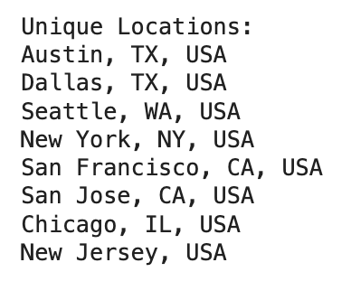
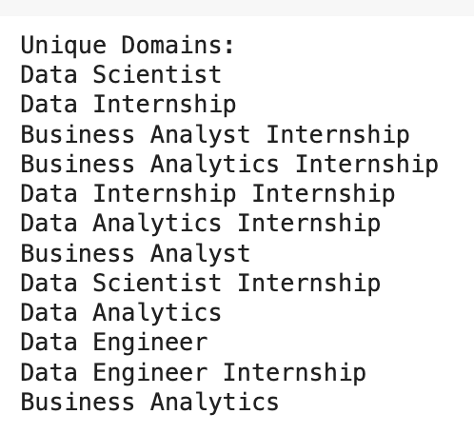
LOCATIONS AND JOB DOMAINS:

Slide 12
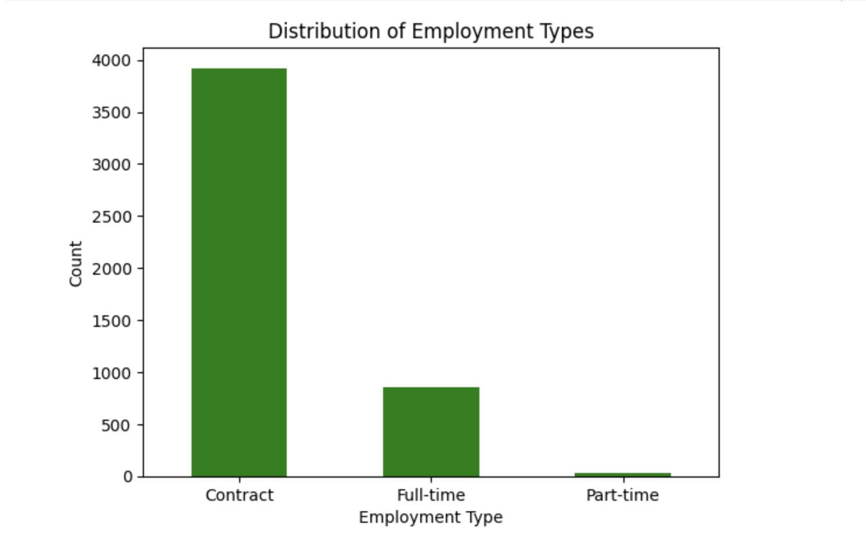
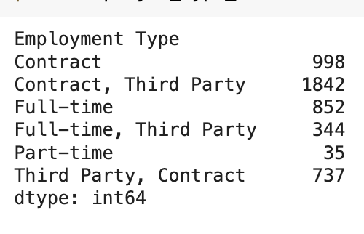
DISTRIBUTION OF EMPLOYMENT TYPES
Contract Roles: 3,921
Dominant employment type
Reflects trend towards flexible job arrangements
Full-Time Roles: 852
Less common compared to contract roles
Indicates stability preference and economic factors
Part-Time Roles: 35
Least frequent
Suggests limited availability or demand for such roles

Slide 13
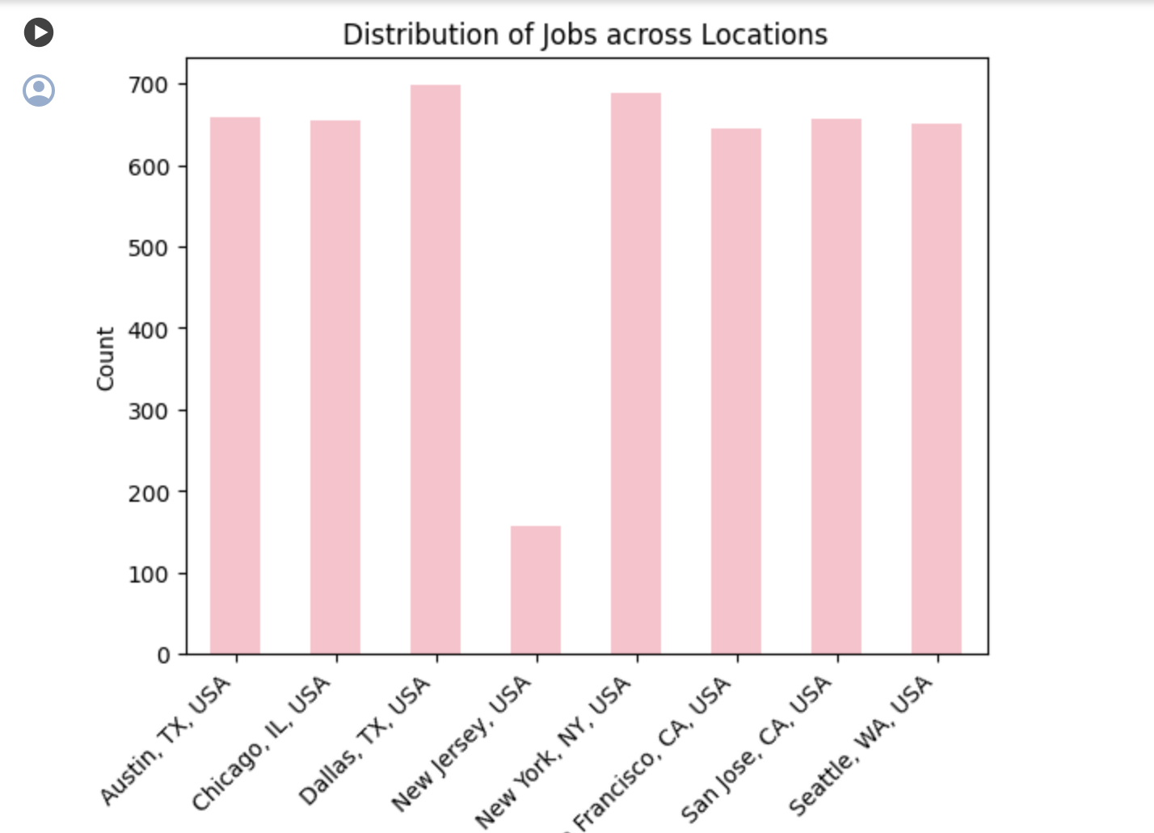
DISTRIBUTION OF JOBS ACROSS LOCATIONS
Dallas, TX: 698 jobs. Leading in job count.
New York, NY: 688 jobs. Significant employment opportunities.
Austin, TX: 658 jobs. Strong market, growth opportunities.
San Jose, CA: 656 jobs. Central tech hub.
Chicago, IL: 655 jobs. Reflects robust economic sector.
Seattle, WA: 651 jobs. Diverse job availability.
San Francisco, CA: 645 jobs. Focus on tech and innovation.
New Jersey: 157 jobs. Lower job count, regional variation.

Slide 14
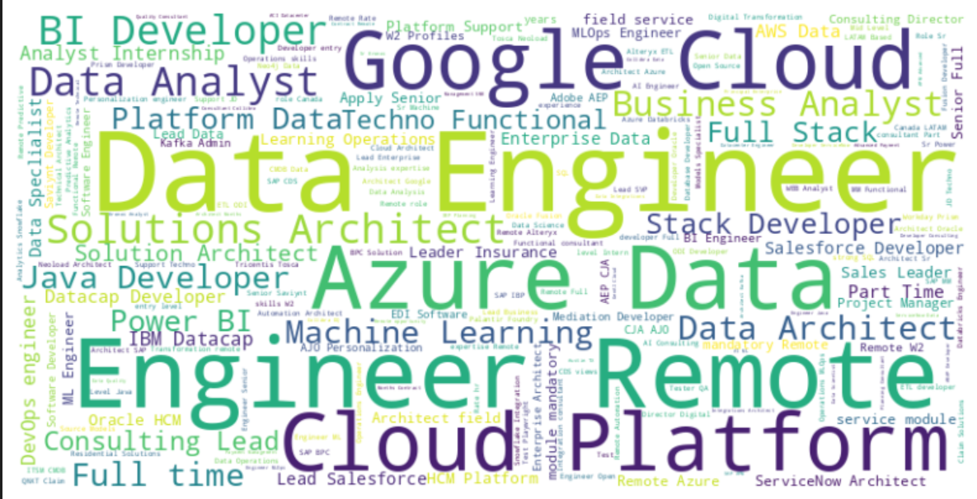
ANALYZING THE DENSITY OF JOB TITLES OCCURRENCE
“Word Cloud Analysis Highlights Dominance of Data Engineering and Cloud Platforms in Current Job Market”
Dominant Terms: "Engineer," "Data," "Cloud," and "Remote" are highly prevalent, reflecting significant demand in these areas.
Key Roles: "Solutions Architect," "Data Engineer," and "BI Developer" are frequently mentioned, indicating specialized roles in high demand.
Technology Focus: Strong emphasis on "Azure" and "Google Cloud," showcasing the importance of these platforms in the tech job market.
Remote Opportunities: Numerous positions offer remote work, highlighting a shift towards flexible job environments.

Slide 15
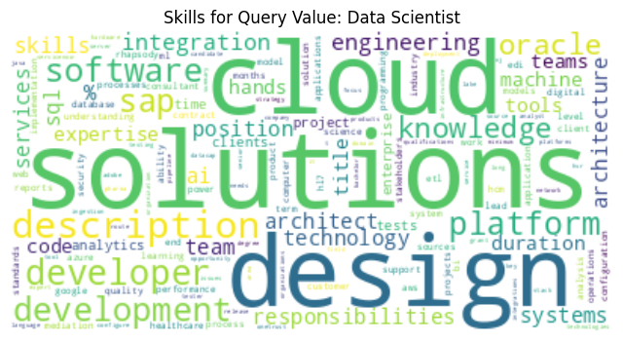
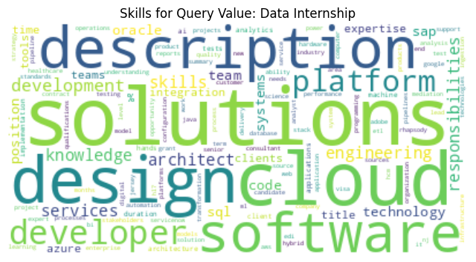
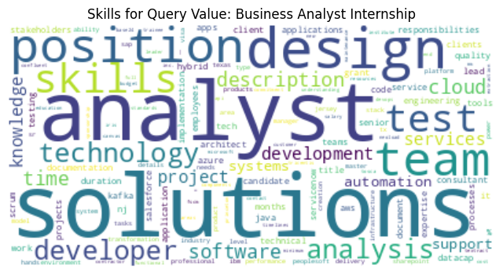
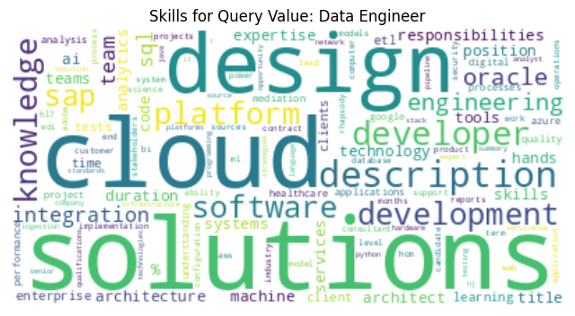
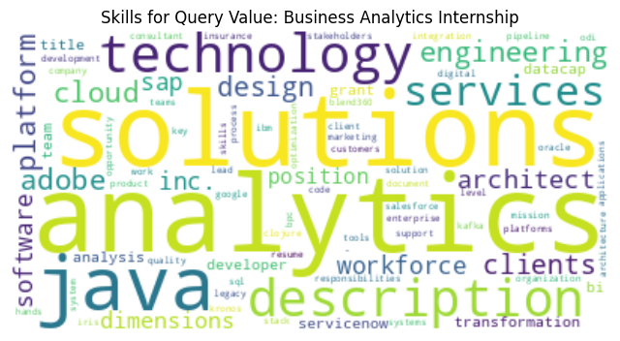
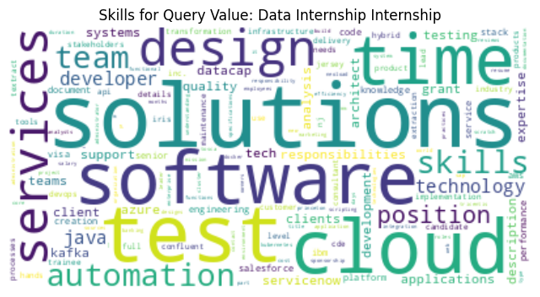
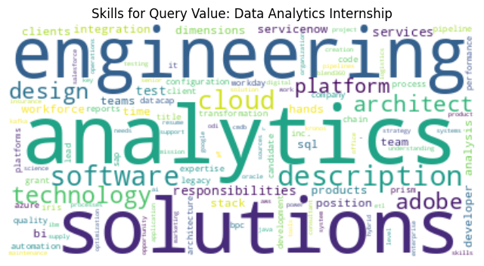
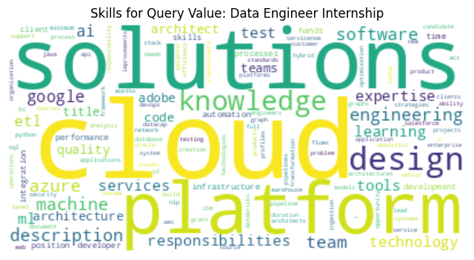
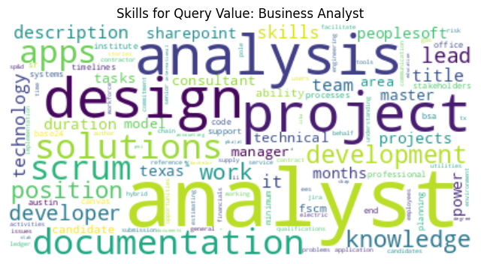
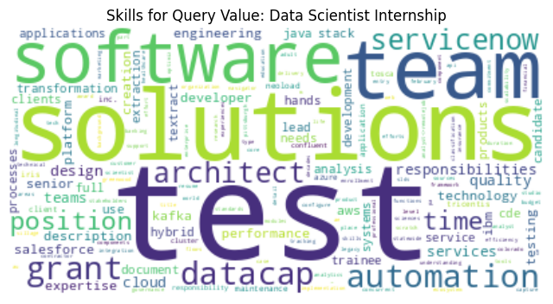
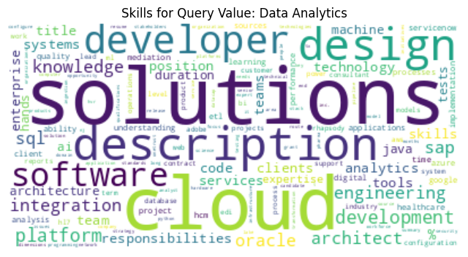
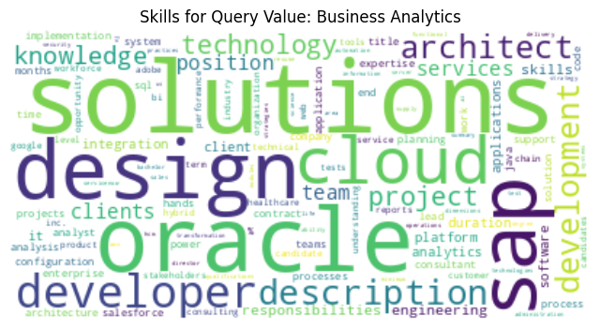
Essential Skills Required for Key Data-Related Job Roles

Slide 16
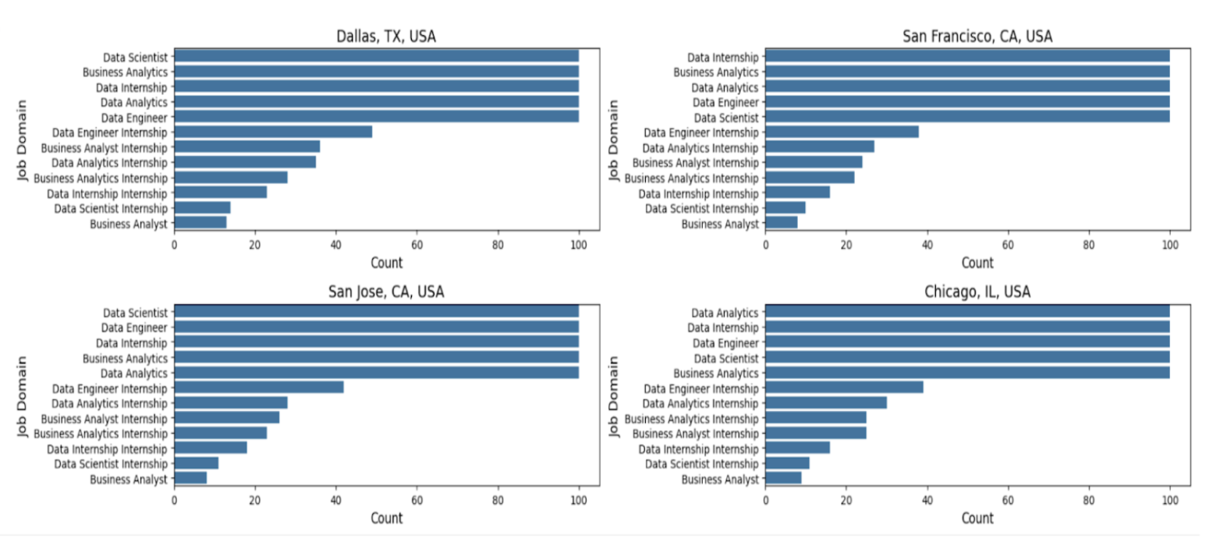
COUNT OF JOB POSTING TITLE DOMAIN BASIS THE LOCATIONS

Slide 17
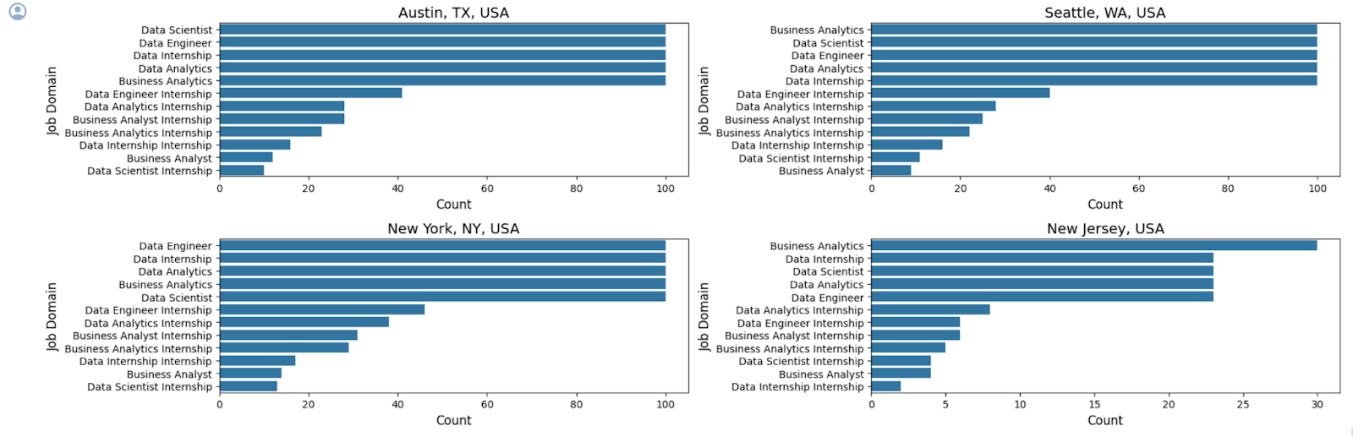
COUNT OF JOB POSTING TITLE DOMAIN BASIS THE LOCATIONS

Slide 18
"Tech Job Trends: Dallas and New York Lead in Roles, San Jose in Internships"
Dallas, TX : Data Scientist positions are most common.
San Francisco, CA : High demand for Data Internships and Business Analytics.
San Jose, CA : Similar to San Francisco, with a strong presence of Data Scientist and Data Engineer roles.
Chicago, IL : Data Analytics roles are most prevalent.
Austin, TX : Data Scientist roles lead, followed by Data Engineer positions.
New York, NY : Broad distribution, with Data Engineer slightly leading.
Seattle, WA : Business Analytics is the most common role.
New Jersey : Smaller range of roles, with Business Analytics and Data Scientist internships leading.

Slide 19
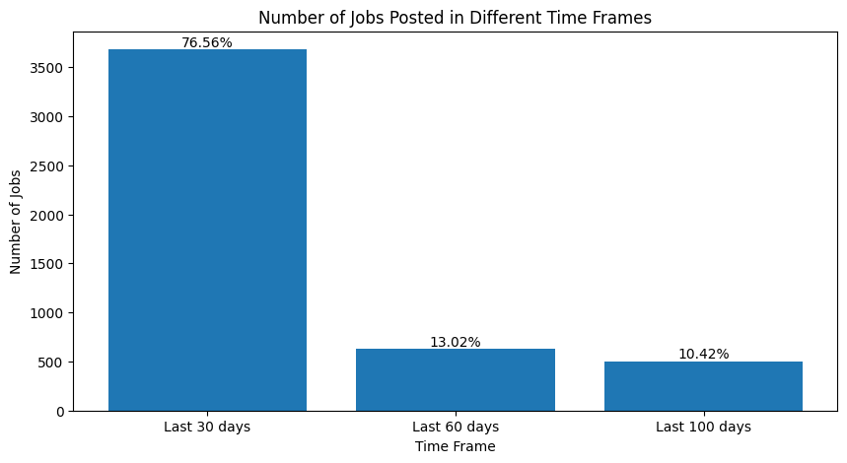
NUMBER OF JOB POSTED IN DIFFERENT TIME FRAMES
"Job Postings Surge, Then Dip: 30-Day Spike Suggests Growth, Followed by a 100-Day Hiring Freeze."
Last 30 Days: Approximately 3,500 jobs posted, indicating a high level of recent activity.
Last 60 Days: Around 1,500 jobs posted, showing a decrease compared to the more recent 30-day period.
Last 100 Days: Data shows a further reduction in job postings, suggesting a significant drop in activity compared to the 60-day timeframe.

Slide 20
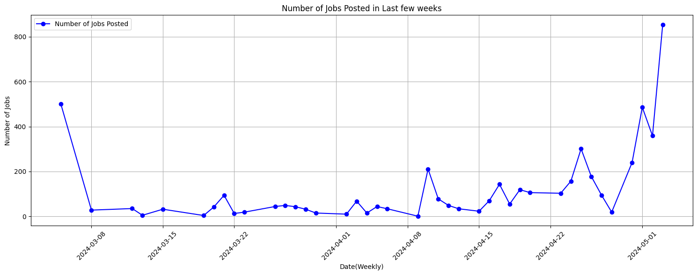
"Sharp Rise in Job Postings Marks a Dynamic Close to the 60-Day Employment Trend"
Overall Trend:
The number of job postings fluctuates significantly over the period, with a dramatic increase towards the end of the 90 days.
Key Observations:
Early spike followed by a sharp decline, then a gradual increase with periodic fluctuations.
A sharp rise in job postings in the final weeks indicates a sudden surge in job market activity.

Slide 21
CONCLUSION
As we can see Linkedin, Indeed and Handshake is not the only Platform to apply or post for the job applications. Dice is one of the booming platform to search and apply for data related jobs.
Basis the analysis we can identify bay area is not the only place where there are maximum job opportunities. Locations such as Dallas, New York and Austin are leading equally
Data Scientist is the most sought after Job Domain across locations and Contractual Job Postings are hiked in comparison to Full Time Job Postings.

Slide 22

TEAM DICE
TEAM DICE
Mahima Advilkar
Priyanka Ayyagari
Navin Kishore
Abhinav Krishnamoorthy
Prasad Pilankar
Anurag Reddy
Manan Upadhyay

Slide 23
Q&A

Slide 24
Thank You!

